Slide 1

Chapter 15 Representation Learning
15 Representation Learning
Acknowledge to: Xirong Lu
Organizers: Guoqiang Zhong, Zhaoyang Niu
Machine Learning Research Group
Ocean University of China
Qingdao, China
https://github.com/AdolfKing/DeepLearningSlides

Slide 2

Chapter 15 Representation Learning
15.1 Greedy Layer-Wise Unsupervised Pretraining
15.2 Transfer Learning and Domain Adaptation
15.3 Semi-Supervised Disentangling of Causal Factors
15.4 Distributed Representation
15.5 Exponential Gains from Depth
15.6 Providing Clues to Discover Underlying Causes

Slide 3
15 Representation Learning
In this chapter, we ﬁrst discuss what it means to learn representations and how the notion of representation can be useful to design deep architectures. We discuss how learning algorithms share statistical strength across diﬀerent tasks, including using information from unsupervised tasks to perform supervised tasks. Shared representations are useful to handle multiple modalities or domains, or to transfer learned knowledge to tasks for which few or no examples are given but a task representation exists. Finally, we step back and argue about the reasons for the success of representation learning, starting with the theoretical advantages of distributed representations (Hinton et al., 1986) and deep representations and ending with the more general idea of underlying assumptions about the data generating process, in particular about underlying causes of the observed data.

Slide 4
15 Representation Learning
Many information processing tasks can be very easy or very diﬃcult depending on how the information is represented. This is a general principle applicable to daily life, computer science in general, and to machine learning. For example, it is straightforward for a person to divide 210 by 6 using long division. The task becomes considerably less straightforward if it is instead posed using the Roman numeral representation of the numbers. Most modern people asked to divide CCX by VI would begin by converting the numbers to the Arabic numeral representation, permitting long division procedures that make use of the place value system. More concretely, we can quantify the asymptotic runtime of various operations using appropriate or inappropriate representations.

Slide 5
15 Representation Learning
For example, inserting a number into the correct position in a sorted list of numbers is an O(n) operation if the list is represented as a linked list, but only O(log n) if the list is represented as a red-black tree.
In the context of machine learning, what makes one representation better than another? Generally speaking, a good representation is one that makes a subsequent learning task easier. The choice of representation will usually depend on the choice of the subsequent learning task.
We can think of feedforward networks trained by supervised learning as performing a kind of representation learning. Speciﬁcally, the last layer of the network is typically a linear classiﬁer, such as a softmax regression classiﬁer.

Slide 6
15 Representation Learning
The rest of the network learns to provide a representation to this classiﬁer. Training with a supervised criterion naturally leads to the representation at every hidden layer (but more so near the top hidden layer) taking on properties that make the classiﬁcation task easier. For example, classes that were not linearly separable in the input features may become linearly separable in the last hidden layer. In principle, the last layer could be another kind of model, such as a nearest neighbor classiﬁer (Salakhutdinov and Hinton, 2007a). The features in the penultimate layer should learn diﬀerent properties depending on the type of the last layer.
Supervised training of feedforward networks does not involve explicitly imposing any condition on the learned intermediate features.

Slide 7
15 Representation Learning
Other kinds of representation learning algorithms are often explicitly designed to shape the representation in some particular way. For example, suppose we want to learn a representation that makes density estimation easier. Distributions with more independences are easier to model, so we could design an objective function that encourages the elements of the representation vector h to be independent. Just like supervised networks, unsupervised deep learning algorithms have a main training objective but also learn a representation as a side eﬀect. Regardless of how a representation was obtained, it can be used for another task. Alternatively, multiple tasks (some supervised, some unsupervised) can be learned together with some shared internal representation.

Slide 8
15 Representation Learning
Most representation learning problems face a trade oﬀ between preserving as much information about the input as possible and attaining nice properties (such as independence).
Representation learning is particularly interesting because it provides one way to perform unsupervised and semi-supervised learning. We often have very large amounts of unlabeled training data and relatively little labeled training data. Training with supervised learning techniques on the labeled subset often results in severe overﬁtting. Semi-supervised learning oﬀers the chance to resolve this overﬁtting problem by also learning from the unlabeled data. Speciﬁcally, we can learn good representations for the unlabeled data, and then use these representations to solve the supervised learning task.

Slide 9
15 Representation Learning
Humans and animals are able to learn from very few labeled examples. We do not yet know how this is possible. Many factors could explain improved human performance—for example, the brain may use very large ensembles of classiﬁers or Bayesian inference techniques. One popular hypothesis is that the brain is able to leverage unsupervised or semi-supervised learning. There are many ways to leverage unlabeled data. In this chapter, we focus on the hypothesis that the unlabeled data can be used to learn a good representation.

Slide 10
Chapter 15 Representation Learning
15.1 Greedy Layer-Wise Unsupervised Pretraining
Acknowledge to: Xirong Lu
Organizers: Guoqiang Zhong, Zhaoyang Niu
Machine Learning Research Group
Ocean University of China
Qingdao, China
https://github.com/AdolfKing/DeepLearningSlides

Slide 11
15.1 Greedy Layer-Wise Unsupervised Pretraining
Unsupervised learning played a key historical role in the revival of deep neural networks, allowing for the ﬁrst time to train a deep supervised network without requiring architectural specializations like convolution or recurrence. We call this procedure unsupervised pretraining, or more precisely, greedy layer-wise unsupervised pretraining. This procedure is a canonical example of how a representation learned for one task (unsupervised learning, trying to capture the shape of the input distribution) can sometimes be useful for another task (supervised learning with the same input domain).

Slide 12
15.1 Greedy Layer-Wise Unsupervised Pretraining
Greedy layer-wise unsupervised pretraining relies on a single-layer representation learning algorithm such as an RBM, a single-layer autoencoder, a sparse coding model, or another model that learns latent representations. Each layer is pretrained using unsupervised learning, taking the output of the previous layer and producing as output a new representation of the data, whose distribution (or its relation to other variables such as categories to predict) is hopefully simpler. See Algorithm 15.1 for a formal description.

Slide 13
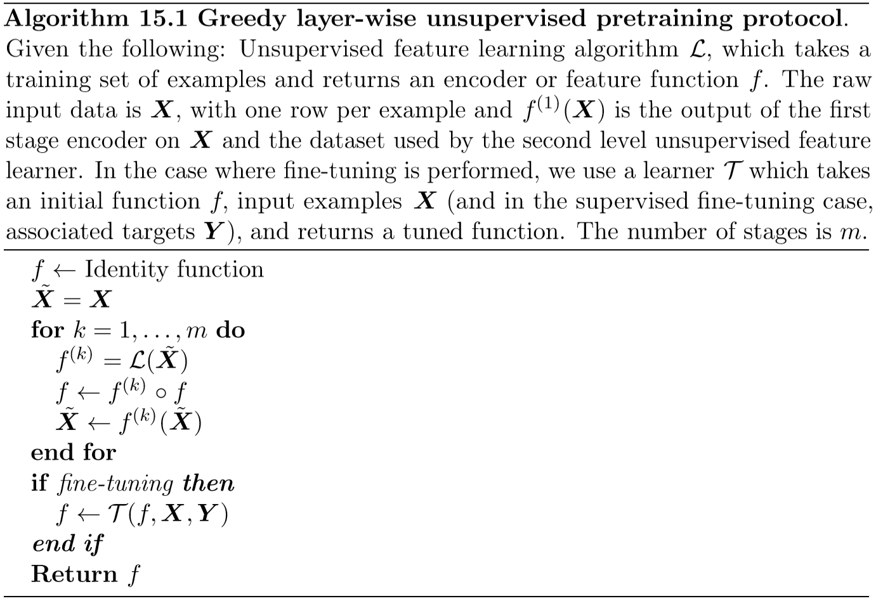
15.1 Greedy Layer-Wise Unsupervised Pretraining

Slide 14
15.1 Greedy Layer-Wise Unsupervised Pretraining
Greedy layer-wise training procedures based on unsupervised criteria have long been used to sidestep the diﬃculty of jointly training the layers of a deep neural net for a supervised task. This approach dates back at least as far as the Neocognitron (Fukushima, 1975). The deep learning renaissance of 2006 began with the discovery that this greedy learning procedure could be used to ﬁnd a good initialization for a joint learning procedure over all the layers, and that this approach could be used to successfully train even fully connected architectures (Hinton et al., 2006; Hinton and Salakhutdinov, 2006; Hinton, 2006; Bengio et al., 2007; Ranzato et al., 2007a). Prior to this discovery, only convolutional deep networks or networks whose depth resulted from recurrence were regarded as feasible to train.

Slide 15
15.1 Greedy Layer-Wise Unsupervised Pretraining
Today, we now know that greedy layer-wise pretraining is not required to train fully connected deep architectures, but the unsupervised pretraining approach was the ﬁrst method to succeed.
Greedy layer-wise pretraining is called greedy because it is a greedy algorithm, meaning that it optimizes each piece of the solution independently, one piece at a time, rather than jointly optimizing all pieces. It is called layer-wise because these independent pieces are the layers of the network. Speciﬁcally, greedy layer-wise pretraining proceeds one layer at a time, training the k-th layer while keeping the previous ones ﬁxed. In particular, the lower layers (which are trained ﬁrst) are not adapted after the upper layers are introduced. It is called unsupervised because each layer is trained with an unsupervised representation learning algorithm.

Slide 16
15.1 Greedy Layer-Wise Unsupervised Pretraining
However it is also called pretraining, because it is supposed to be only a ﬁrst step before a joint training algorithm is applied to ﬁne-tune all the layers together. In the context of a supervised learning task, it can be viewed as a regularizer (in some experiments, pretraining decreases test error without decreasing training error) and a form of parameter initialization.
It is common to use the word “pretraining” to refer not only to the pretraining stage itself but to the entire two phase protocol that combines the pretraining phase and a supervised learning phase. The supervised learning phase may involve training a simple classiﬁer on top of the features learned in the pretraining phase, or it may involve supervised ﬁne-tuning of the entire network learned in the pretraining phase.

Slide 17
15.1 Greedy Layer-Wise Unsupervised Pretraining
No matter what kind of unsupervised learning algorithm or what model type is employed, in the vast majority of cases, the overall training scheme is nearly the same. While the choice of unsupervised learning algorithm will obviously impact the details, most applications of unsupervised pretraining follow this basic protocol.
Greedy layer-wise unsupervised pretraining can also be used as initialization for other unsupervised learning algorithms, such as deep autoencoders (Hinton and Salakhutdinov, 2006) and probabilistic models with many layers of latent variables. Such models include deep belief networks (Hinton et al., 2006) and deep Boltzmann machines (Salakhutdinov and Hinton, 2009a). These deep generative models will be described in Chapter 20.

Slide 18
15.1 Greedy Layer-Wise Unsupervised Pretraining
As discussed in Sec. 8.7.4, it is also possible to have greedy layer-wise supervised pretraining. This builds on the premise that training a shallow network is easier than training a deep one, which seems to have been validated in several contexts (Erhan et al., 2010).
On many tasks, greedy layer-wise unsupervised pretraining can yield substantial improvements in test error for classiﬁcation tasks. This observation was responsible for the renewed interested in deep neural networks starting in 2006 (Hinton et al., 2006; Bengio et al., 2007; Ranzato et al., 2007a).

Slide 19
15.1.1 When and Why Does Unsupervised Pretraining Work?
On many other tasks, however, unsupervised pretraining either does not confer a beneﬁt or even causes noticeable harm. Ma et al. (2015) studied the eﬀect of pretraining on machine learning models for chemical activity prediction and found that, on average, pretraining was slightly harmful, but for many tasks was signiﬁcantly helpful. Because unsupervised pretraining is sometimes helpful but often harmful it is important to understand when and why it works in order to determine whether it is applicable to a particular task.

Slide 20
15.1.1 When and Why Does Unsupervised Pretraining Work?
At the outset, it is important to clarify that most of this discussion is restricted to greedy unsupervised pretraining in particular. There are other, completely diﬀerent paradigms for performing semi-supervised learning with neural networks, such as virtual adversarial training described in Sec. 7.13. It is also possible to train an autoencoder or generative model at the same time as the supervised model. Examples of this single-stage approach include the discriminative RBM (Larochelle and Bengio, 2008) and the ladder network (Rasmus et al., 2015), in which the total objective is an explicit sum of the two terms (one using the labels and one only using the input).

Slide 21
15.1.1 When and Why Does Unsupervised Pretraining Work?
Unsupervised pretraining combines two diﬀerent ideas. First, it makes use of the idea that the choice of initial parameters for a deep neural network can have a signiﬁcant regularizing eﬀect on the model (and, to a lesser extent, that it can improve optimization). Second, it makes use of the more general idea that learning about the input distribution can help to learn about the mapping from inputs to outputs.
Both of these ideas involve many complicated interactions between several parts of the machine learning algorithm that are not entirely understood.

Slide 22
15.1.1 When and Why Does Unsupervised Pretraining Work?
The ﬁrst idea, that the choice of initial parameters for a deep neural network can have a strong regularizing eﬀect on its performance, is the least well understood. At the time that pretraining became popular, it was understood as initializing the model in a location that would cause it to approach one local minimum rather than another. Today, local minima are no longer considered to be a serious problem for neural network optimization. We now know that our standard neural network training procedures usually do not arrive at a critical point of any kind.

Slide 23
15.1.1 When and Why Does Unsupervised Pretraining Work?
It remains possible that pretraining initializes the model in a location that would otherwise be inaccessible—for example, a region that is surrounded by areas where the cost function varies so much from one example to another that minibatches give only a very noisy estimate of the gradient, or a region surrounded by areas where the Hessian matrix is so poorly conditioned that gradient descent methods must use very small steps. However, our ability to characterize exactly what aspects of the pretrained parameters are retained during the supervised training stage is limited. This is one reason that modern approaches typically use simultaneous unsupervised learning and supervised learning rather than two sequential stages.

Slide 24
15.1.1 When and Why Does Unsupervised Pretraining Work?
One may also avoid struggling with these complicated ideas about how optimization in the supervised learning stage preserves information from the unsupervised learning stage by simply freezing the parameters for the feature extractors and using supervised learning only to add a classiﬁer on top of the learned features.
The other idea, that a learning algorithm can use information learned in the unsupervised phase to perform better in the supervised learning stage, is better understood. The basic idea is that some features that are useful for the unsupervised task may also be useful for the supervised learning task.

Slide 25
15.1.1 When and Why Does Unsupervised Pretraining Work?
For example, if we train a generative model of images of cars and motorcycles, it will need to know about wheels, and about how many wheels should be in an image. If we are fortunate, the representation of the wheels will take on a form that is easy for the supervised learner to access. This is not yet understood at a mathematical, theoretical level, so it is not always possible to predict which tasks will beneﬁt from unsupervised learning in this way. Many aspects of this approach are highly dependent on the speciﬁc models used. For example, if we wish to add a linear classiﬁer on top of pretrained features, the features must make the underlying classes linearly separable. These properties often occur naturally but do not always do so.

Slide 26
15.1.1 When and Why Does Unsupervised Pretraining Work?
This is another reason that simultaneous supervised and unsupervised learning can be preferable—the constraints imposed by the output layer are naturally included from the start.
From the point of view of unsupervised pretraining as learning a representation, we can expect unsupervised pretraining to be more eﬀective when the initial representation is poor. One key example of this is the use of word embeddings. Words represented by one-hot vectors are not very informative because every two distinct one-hot vectors are the same distance from each other (squared L² distance of 2). Learned word embeddings naturally encode similarity between words by their distance from each other.

Slide 27
15.1.1 When and Why Does Unsupervised Pretraining Work?
Because of this, unsupervised pretraining is especially useful when processing words. It is less useful when processing images, perhaps because images already lie in a rich vector space where distances provide a low quality similarity metric.
From the point of view of unsupervised pretraining as a regularizer, we can expect unsupervised pretraining to be most helpful when the number of labeled examples is very small. Because the source of information added by unsupervised pretraining is the unlabeled data, we may also expect unsupervised pretraining to perform best when the number of unlabeled examples is very large.

Slide 28
15.1.1 When and Why Does Unsupervised Pretraining Work?
The advantage of semi-supervised learning via unsupervised pretraining with many unlabeled examples and few labeled examples was made particularly clear in 2011 with unsupervised pretraining winning two international transfer learning competitions (Mesnil et al., 2011; Goodfellow et al., 2011), in settings where the number of labeled examples in the target task was small (from a handful to dozens of examples per class). These eﬀects were also documented in carefully controlled experiments by Paine et al. (2014).

Slide 29
15.1.1 When and Why Does Unsupervised Pretraining Work?
Other factors are likely to be involved. For example, unsupervised pretraining is likely to be most useful when the function to be learned is extremely complicated. Unsupervised learning diﬀers from regularizers like weight decay because it does not bias the learner toward discovering a simple function but rather toward discovering feature functions that are useful for the unsupervised learning task. If the true underlying functions are complicated and shaped by regularities of the input distribution, unsupervised learning can be a more appropriate regularizer.
These caveats aside, we now analyze some success cases where unsupervised pretraining is known to cause an improvement, and explain what is known about why this improvement occurs.

Slide 30
15.1.1 When and Why Does Unsupervised Pretraining Work?
However, unsupervised pretraining can help tasks other than classiﬁcation, and can act to improve optimization rather than being merely a regularizer. For example, it can improve both train and test reconstruction error for deep autoencoders (Hinton and Salakhutdinov, 2006).
Erhan et al. (2010) performed many experiments to explain several successes of unsupervised pretraining. Both improvements to training error and improvements to test error may be explained in terms of unsupervised pretraining taking the parameters into a region that would otherwise be inaccessible. Neural network training is non-deterministic, and converges to a diﬀerent function every time it is run.

Slide 31
15.1.1 When and Why Does Unsupervised Pretraining Work?
Training may halt at a point where the gradient becomes small, a point where early stopping ends training to prevent overﬁtting, or at a point where the gradient is large but it is diﬃcult to ﬁnd a downhill step due to problems such as stochasticity or poor conditioning of the Hessian. Neural networks that receive unsupervised pretraining consistently halt in the same region of function space, while neural networks without pretraining consistently halt in another region. See Fig. 15.1 for a visualization of this phenomenon. The region where pretrained networks arrive is smaller, suggesting that pretraining reduces the variance of the estimation process, which can in turn reduce the risk of severe over-ﬁtting.

Slide 32
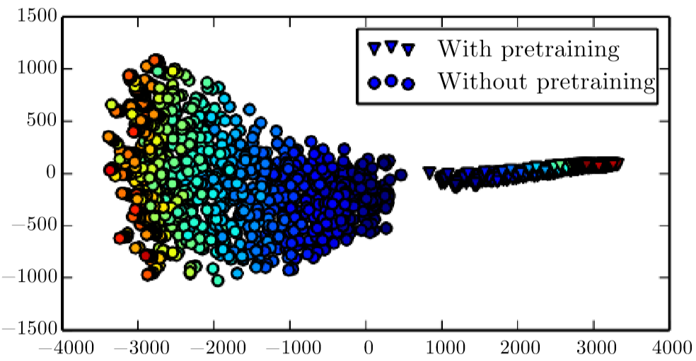
15.1.1 When and Why Does Unsupervised Pretraining Work?
Figure 15.1: Visualization via nonlinear projection of the learning trajectories of diﬀerent neural networks in function space (not parameter space, to avoid the issue of many-to-one mappings from parameter vectors to functions), with diﬀerent random initializations and with or without unsupervised pretraining. Each point corresponds to a diﬀerent neural network, at a particular time during its training process. This ﬁgure is adapted with permission from Erhan et al. (2010). A coordinate in function space is an inﬁnite-dimensional vector associating every input x with an output y. Erhan et al. (2010) made a linear projection to high-dimensional space by concatenating the y for many speciﬁc x points.

Slide 33
15.1.1 When and Why Does Unsupervised Pretraining Work?
Figure 15.1: They then made a further nonlinear projection to 2-D by Isomap (Tenenbaum et al., 2000). Color indicates time. All networks are initialized near the center of the plot (corresponding to the region of functions that produce approximately uniform distributions over the class y for most inputs). Over time, learning moves the function outward, to points that make strong predictions. Training consistently terminates in one region when using pretraining and in another, non-overlapping region when not using pretraining. Isomap tries to preserve global relative distances (and hence volumes) so the small region corresponding to pretrained models may indicate that the pretraining-based estimator has reduced variance.

Slide 34
15.1.1 When and Why Does Unsupervised Pretraining Work?
In other words, unsupervised pretraining initializes neural network parameters into a region that they do not escape, and the results following this initialization are more consistent and less likely to be very bad than without this initialization.
Erhan et al. (2010) also provide some answers as to when pretraining works best—the mean and variance of the test error were most reduced by pretraining for deeper networks. Keep in mind that these experiments were performed before the invention and popularization of modern techniques for training very deep networks (rectiﬁed linear units, dropout and batch normalization) so less is known about the eﬀect of unsupervised pretraining in conjunction with contemporary approaches.

Slide 35
15.1.1 When and Why Does Unsupervised Pretraining Work?
An important question is how unsupervised pretraining can act as a regularizer. One hypothesis is that pretraining encourages the learning algorithm to discover features that relate to the underlying causes that generate the observed data. This is an important idea motivating many other algorithms besides unsupervised pretraining, and is described further in Sec. 15.3.
Compared to other ways of incorporating this belief by using unsupervised learning, unsupervised pretraining has the disadvantage that it operates with two separate training phases. One reason that these two training phases are disadvantageous is that there is not a single hyperparameter that predictably reduces or increases the strength of the regularization arising from the unsupervised pretraining.

Slide 36
15.1.1 When and Why Does Unsupervised Pretraining Work?
Instead, there are very many hyperparameters, whose eﬀect may be measured after the fact but is often diﬃcult to predict ahead of time. When we perform unsupervised and supervised learning simultaneously, instead of using the pretraining strategy, there is a single hyperparameter, usually a coeﬃcient attached to the unsupervised cost, that determines how strongly the unsupervised objective will regularize the supervised model. One can always predictably obtain less regularization by decreasing this coeﬃcient. In the case of unsupervised pretraining, there is not a way of ﬂexibly adapting the strength of the regularization—either the supervised model is initialized to pretrained parameters, or it is not.

Slide 37
15.1.1 When and Why Does Unsupervised Pretraining Work?
Another disadvantage of having two separate training phases is that each phase has its own hyperparameters. The performance of the second phase usually cannot be predicted during the ﬁrst phase, so there is a long delay between proposing hyperparameters for the ﬁrst phase and being able to update them using feedback from the second phase. The most principled approach is to use validation set error in the supervised phase in order to select the hyperparameters of the pretraining phase, as discussed in Larochelle et al. (2009). In practice, some hyper-parameters, like the number of pretraining iterations, are more conveniently set during the pretraining phase, using early stopping on the unsupervised objective, which is not ideal but computationally much cheaper than using the supervised objective.

Slide 38
15.1.1 When and Why Does Unsupervised Pretraining Work?
Today, unsupervised pretraining has been largely abandoned, except in the ﬁeld of natural language processing, where the natural representation of words as one-hot vectors conveys no similarity information and where very large unlabeled sets are available. In that case, the advantage of pretraining is that one can pretrain once on a huge unlabeled set (for example with a corpus containing billions of words), learn a good representation (typically of words, but also of sentences), and then use this representation or ﬁne-tune it for a supervised task for which the training set contains substantially fewer examples. This approach was pioneered by Collobert and Weston (2008b), Turian et al. (2010), and Collobert et al. (2011a) and remains in common use today.

Slide 39
15.1.1 When and Why Does Unsupervised Pretraining Work?
Deep learning techniques based on supervised learning, regularized with dropout or batch normalization, are able to achieve human-level performance on very many tasks, but only with extremely large labeled datasets. These same techniques outperform unsupervised pretraining on medium-sized datasets such as CIFAR-10 and MNIST, which have roughly 5,000 labeled examples per class. On extremely small datasets, such as the alternative splicing dataset, Bayesian methods outperform methods based on unsupervised pretraining (Srivastava, 2013). For these reasons, the popularity of unsupervised pretraining has declined. Nevertheless, unsupervised pretraining remains an important milestone in the history of deep learning research and continues to inﬂuence contemporary approaches.

Slide 40
15.1.1 When and Why Does Unsupervised Pretraining Work?
The idea of pretraining has been generalized to supervised pretraining discussed in Sec. 8.7.4, as a very common approach for transfer learning. Supervised pretraining for transfer learning is popular (Oquab et al., 2014; Yosinski et al., 2014) for use with convolutional networks pretrained on the ImageNet dataset. Practitioners publish the parameters of these trained networks for this purpose, just like pretrained word vectors are published for natural language tasks (Collobert et al., 2011a; Mikolov et al., 2013a).

Slide 41
Chapter 15 Representation Learning
15.2 Transfer Learning and Domain Adaptation
Acknowledge to: Xirong Lu
Organizers: Guoqiang Zhong, Zhaoyang Niu
Machine Learning Research Group
Ocean University of China
Qingdao, China
https://github.com/AdolfKing/DeepLearningSlides

Slide 42
15.2 Transfer Learning and Domain Adaptation
Transfer learning and domain adaptation refer to the situation where what has been learned in one setting (i.e., distribution P₁) is exploited to improve generalization in another setting (say distribution P₂). This generalizes the idea presented in the previous section, where we transferred representations between an unsupervised learning task and a supervised learning task.
In transfer learning, the learner must perform two or more different tasks, but we assume that many of the factors that explain the variations in P₁ are relevant to the variations that need to be captured for learning P₂. This is typically understood in a supervised learning context, where the input is the same but the target may be of a different nature.

Slide 43
15.2 Transfer Learning and Domain Adaptation
For example, we may learn about one set of visual categories, such as cats and dogs, in the ﬁrst setting, then learn about a different set of visual categories, such as ants and wasps, in the second setting. If there is signiﬁcantly more data in the ﬁrst setting (sampled from P₁), then that may help to learn representations that are useful to quickly generalize from only very few examples drawn from P₂. Many visual categories share low-level notions of edges and visual shapes, the effects of geometric changes, changes in lighting, etc. In general, transfer learning, multi-task learning (Sec. 7.7), and domain adaptation can be achieved via representation learning when there exist features that are useful for the different settings or tasks, corresponding to underlying factors that appear in more than one setting.

Slide 44
15.2 Transfer Learning and Domain Adaptation
This is illustrated in Fig. 7.2, with shared lower layers and task-dependent upper layers.
However, sometimes, what is shared among the different tasks is not the semantics of the input but the semantics of the output. For example, a speech recognition system needs to produce valid sentences at the output layer, but the earlier layers near the input may need to recognize very different versions of the same phonemes or sub-phonemic vocalizations depending on which person is speaking. In cases like these, it makes more sense to share the upper layers (near the output) of the neural network, and have a task-speciﬁc preprocessing, as illustrated in Fig. 15.2.

Slide 45
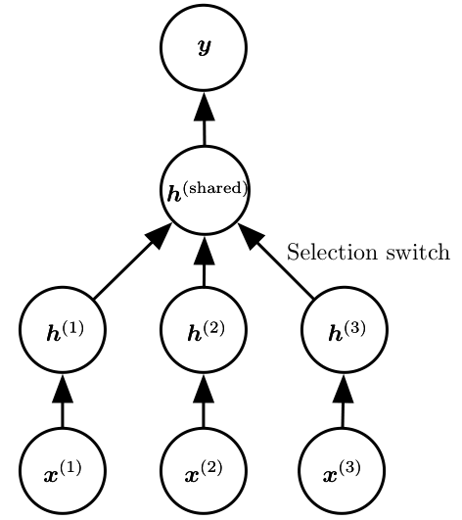
15.2 Transfer Learning and Domain Adaptation
Figure 15.2: Example architecture for multi-task or transfer learning when the output variable y has the same semantics for all tasks while the input variable x has a different meaning (and possibly even a different dimension) for each task (or, for example, each user), called x⁽¹⁾, x⁽²⁾ and x⁽³⁾ for three tasks. The lower levels (up to the selection switch) are task-speciﬁc, while the upper levels are shared. The lower levels learn to translate their task-speciﬁc input into a generic set of features.

Slide 46
15.2 Transfer Learning and Domain Adaptation
In the related case of domain adaptation, the task (and the optimal input-to-output mapping) remains the same between each setting, but the input distribution is slightly different. For example, consider the task of sentiment analysis, which consists of determining whether a comment expresses positive or negative sentiment. Comments posted on the web come from many categories. A domain adaptation scenario can arise when a sentiment predictor trained on customer reviews of media content such as books, videos and music is later used to analyze comments about consumer electronics such as televisions or smartphones.

Slide 47
15.2 Transfer Learning and Domain Adaptation
One can imagine that there is an underlying function that tells whether any statement is positive, neutral or negative, but of course the vocabulary and style may vary from one domain to another, making it more difficult to generalize across domains. Simple unsupervised pretraining (with denoising autoencoders) has been found to be very successful for sentiment analysis with domain adaptation (Glorot et al., 2011b).
A related problem is that of concept drift, which we can view as a form of transfer learning due to gradual changes in the data distribution over time. Both concept drift and transfer learning can be viewed as particular forms of multi-task learning.

Slide 48
15.2 Transfer Learning and Domain Adaptation
While the phrase “multi-task learning” typically refers to supervised learning tasks, the more general notion of transfer learning is applicable to unsupervised learning and reinforcement learning as well.
In all of these cases, the objective is to take advantage of data from the ﬁrst setting to extract information that may be useful when learning or even when directly making predictions in the second setting. The core idea of representation learning is that the same representation may be useful in both settings. Using the same representation in both settings allows the representation to beneﬁt from the training data that is available for both tasks.

Slide 49
15.2 Transfer Learning and Domain Adaptation
As mentioned before, unsupervised deep learning for transfer learning has found success in some machine learning competitions (Mesnil et al., 2011; Goodfellow et al., 2011). In the first of these competitions, the experimental setup is the following. Each participant is first given a dataset from the ﬁrst setting (from distribution P₁), illustrating examples of some set of categories. The participants must use this to learn a good feature space (mapping the raw input to some representation), such that when we apply this learned transformation to inputs from the transfer setting (distribution P₂), a linear classiﬁer can be trained and generalize well from very few labeled examples.

Slide 50
15.2 Transfer Learning and Domain Adaptation
One of the most striking results found in this competition is that as an architecture makes use of deeper and deeper representations (learned in a purely unsupervised way from data collected in the first setting, P₁), the learning curve on the new categories of the second (transfer) setting P₂ becomes much better. For deep representations, fewer labeled examples of the transfer tasks are necessary to achieve the apparently asymptotic generalization performance.

Slide 51
15.2 Transfer Learning and Domain Adaptation
Two extreme forms of transfer learning are one-shot learning and zero-shot learning, sometimes also called zero-data learning. Only one labeled example of the transfer task is given for one-shot learning, while no labeled examples are given at all for the zero-shot learning task.
One-shot learning (Fei-Fei et al., 2006) is possible because the representation learns to cleanly separate the underlying classes during the first stage. During the transfer learning stage, only one labeled example is needed to infer the label of many possible test examples that all cluster around the same point in representation space.

Slide 52
15.2 Transfer Learning and Domain Adaptation
This works to the extent that the factors of variation corresponding to these invariances have been cleanly separated from the other factors, in the learned representation space, and we have somehow learned which factors do and do not matter when discriminating objects of certain categories.
As an example of a zero-shot learning setting, consider the problem of having a learner read a large collection of text and then solve object recognition problems. It may be possible to recognize a specific object class even without having seen an image of that object, if the text describes the object well enough. For example, having read that a cat has four legs and pointy ears, the learner might be able to guess that an image is a cat, without having seen a cat before.

Slide 53
15.2 Transfer Learning and Domain Adaptation
Zero-data learning (Larochelle et al., 2008) and zero-shot learning (Palatucci et al., 2009; Socher et al., 2013b) are only possible because additional information has been exploited during training. We can think of the zero-data learning scenario as including three random variables: the traditional inputs x, the traditional outputs or targets y, and an additional random variable describing the task, T. The model is trained to estimate the conditional distribution p(y | x, T) where T is a description of the task we wish the model to perform. In our example of recognizing cats after having read about cats, the output is a binary variable y with y = 1 indicating “yes” and y = 0 indicating “no”. The task variable T then represents questions to be answered such as “Is there a cat in this image?”

Slide 54
15.2 Transfer Learning and Domain Adaptation
If we have a training set containing unsupervised examples of objects that live in the same space as T, we may be able to infer the meaning of unseen instances of T. In our example of recognizing cats without having seen an image of the cat, it is important that we have had unlabeled text data containing sentences such as “cats have four legs” or “cats have pointy ears.”
Zero-shot learning requires T to be represented in a way that allows some sort of generalization. For example, T cannot be just a one-hot code indicating an object category. Socher et al. (2013b) provide instead a distributed representation of object categories by using a learned word embedding for the word associated with each category.

Slide 55
15.2 Transfer Learning and Domain Adaptation
A similar phenomenon happens in machine translation (Klementiev et al., 2012; Mikolov et al., 2013b; Gouws et al., 2014): we have words in one language, and the relationships between words can be learned from unilingual corpora; on the other hand, we have translated sentences which relate words in one language with words in the other. Even though we may not have labeled examples translating word A in language X to word B in language Y, we can generalize and guess a translation for word A because we have learned a distributed representation for words in language X, a distributed representation for words in language Y , and created a link (possibly two-way) relating the two spaces, via training examples consisting of matched pairs of sentences in both languages. This transfer will be most successful if all three ingredients (the two representations and the relations between them) are learned jointly.

Slide 56
15.2 Transfer Learning and Domain Adaptation
Zero-shot learning is a particular form of transfer learning. The same principle explains how one can perform multi-modal learning, capturing a representation in one modality, a representation in the other, and the relationship (in general a joint distribution) between pairs (x , y) consisting of one observation x in one modality and another observation y in the other modality (Srivastava and Salakhutdinov, 2012). By learning all three sets of parameters (from x to its representation, from y to its representation, and the relationship between the two representations), concepts in one representation are anchored in the other, and vice-versa, allowing one to meaningfully generalize to new pairs. The procedure is illustrated in Fig. 15.3.

Slide 57
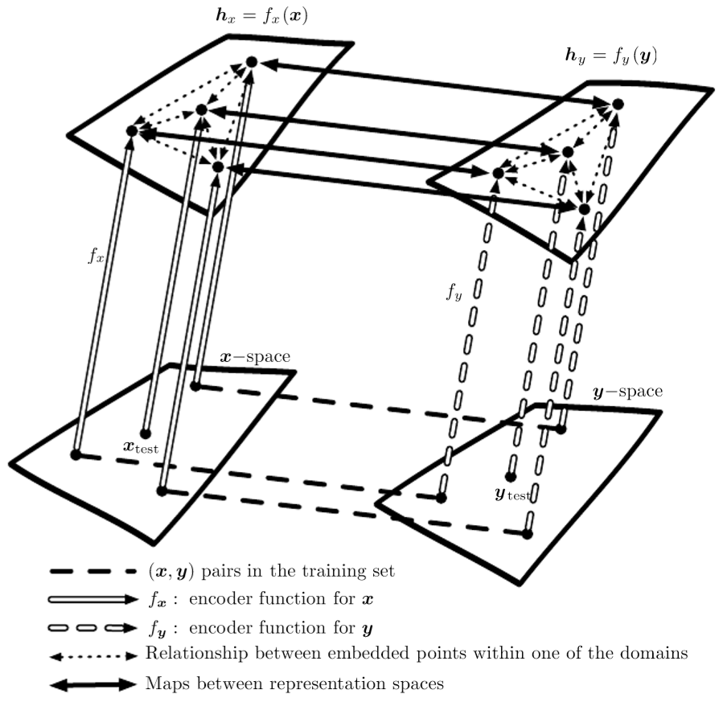
15.2 Transfer Learning and Domain Adaptation
Figure 15.3: Transfer learning between two domains x and y enables zero-shot learning. Labeled or unlabeled examples of x allow one to learn a representation function f_{x} and similarly with examples of y to learn f_{y} . Each application of the f_{x} and f_{y} functions appears as an upward arrow, with the style of the arrows indicating which function is applied. Distance in h_{x} space provides a similarity metric between any pair of points in x space that may be more meaningful than distance in x space. Likewise, distance in h_{y} space provides a similarity metric between any pair of points in y space.

Slide 58
15.2 Transfer Learning and Domain Adaptation
Figure 15.3: Both of these similarity functions are indicated with dotted bidirectional arrows. Labeled examples (dashed horizontal lines) are pairs (x , y) which allow one to learn a one-way or two-way map (solid bidirectional arrow) between the representations f_{x}(x) and the representations f_{y}(y) and anchor these representations to each other. Zero-data learning is then enabled as follows. One can associate an image x_{test} to a word y_{test} , even if no image of that word was ever presented, simply because word-representations f_{y}(y_{test}) and image-representations f_{x}(x_{test}) can be related to each other via the maps between representation spaces. It works because, although that image and that word were never paired, their respective feature vectors f_{x}(x_{test}) and f_{y}(y_{test}) have been related to each other. Figure inspired from suggestion by Hrant Khachatrian.

Slide 59
Chapter 15 Representation Learning
15.3 Semi-Supervised Disentangling of Causal Factors
Acknowledge to: Wei Wan
Organizers: Guoqiang Zhong, Zhaoyang Niu
Machine Learning Research Group
Ocean University of China
Qingdao, China
https://github.com/AdolfKing/DeepLearningSlides

Slide 60
15.3 Semi-Supervised Disentangling of Causal Factors
An important question about representation learning is “what makes one repre- sentation better than another?” One hypothesis is that an ideal representation is one in which the features within the representation correspond to the under- lying causes of the observed data, with separate features or directions in feature space corresponding to different causes, so that the representation disentangles the causes from one another. This hypothesis motivates approaches in which we first seek a good representation for p(x). Such a representation may also be a good representation for computing p(y | x) if y is among the most salient causes of x. This idea has guided a large amount of deep learning research since at least the 1990s (Becker and Hinton, 1992; Hinton and Sejnowski, 1999), in more detail. For other arguments about when semi-supervised learning can outperform pure supervised learning, we refer the reader to Sec. 1.2 of Chapelle et al. (2006).

Slide 61
15.3 Semi-Supervised Disentangling of Causal Factors
In other approaches to representation learning, we have often been concerned with a representation that is easy to model—for example, one whose entries are sparse, or independent from each other. A representation that cleanly separates the underlying causal factors may not necessarily be one that is easy to model. However, a further part of the hypothesis motivating semi-supervised learning via unsupervised representation learning is that for many AI tasks, these two properties coincide: once we are able to obtain the underlying explanations for what we observe, it generally becomes easy to isolate individual attributes from the others. Specifically, if a representation h represents many of the underlying causes of the observed x, and the outputs y are among the most salient causes, then it is easy to predict y from h.

Slide 62
15.3 Semi-Supervised Disentangling of Causal Factors
First, let us see how semi-supervised learning can fail because unsupervised learning of p(x) is of no help to learn p(y | x). Consider for example the case where p(x) is uniformly distributed and we want to learn f (x) = E[y | x]. Clearly, observing a training set of x values alone gives us no information about p(y | x).
Next, let us see a simple example of how semi-supervised learning can succeed. Consider the situation where x arises from a mixture, with one mixture component per value of y, as illustrated in Fig. 15.4. If the mixture components are well- separated, then modeling p(x) reveals precisely where each component is, and a single labeled example of each class will then be enough to perfectly learn p(y | x). But more generally, what could make p(y | x) and p(x) be tied together?

Slide 63
15.3 Semi-Supervised Disentangling of Causal Factors
If y is closely associated with one of the causal factors of x, then p(x) and p(y | x) will be strongly tied, and unsupervised representation learning that tries to disentangle the underlying factors of variation is likely to be useful as a semi-supervised learning strategy.

Slide 64
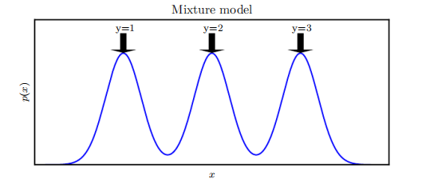
15.3 Semi-Supervised Disentangling of Causal Factors
Figure 15.4: Example of a density over x that is a mixture over three components. The component identity is an underlying explanatory factor, y. Because the mixture components (e.g., natural object classes in image data) are statistically salient, just modeling p(x) in an unsupervised way with no labeled example already reveals the factor y.

Slide 65
15.3 Semi-Supervised Disentangling of Causal Factors
Consider the assumption that y is one of the causal factors of x, and let h represent all those factors. The true generative process can be conceived as structured according to this directed graphical model, with h as the parent of x:
As a consequence, the data has marginal probability

Slide 66
15.3 Semi-Supervised Disentangling of Causal Factors
From this straightforward observation, we conclude that the best possible model of x (from a generalization point of view) is the one that uncovers the above “truestructure, with h as a latent variable that explains the observed variations in x. The “ideal” representation learning discussed above should thus recover these latent factors. If y is one of these (or closely related to one of them), then it will be very easy to learn to predict y from such a representation. We also see that the conditional distribution of y given x is tied by Bayes rule to the components in the above equation:

Slide 67
15.3 Semi-Supervised Disentangling of Causal Factors
Thus the marginal p(x) is intimately tied to the conditional p(y | x) and knowledge of the structure of the former should be helpful to learn the latter. Therefore, in situations respecting these assumptions, semi-supervised learning should improve performance.
An important research problem regards the fact that most observations are formed by an extremely large number of underlying causes. Suppose y = , but the unsupervised learner does not know which . The brute force solution is for an unsupervised learner to learn a representation that captures all the reasonably salient generative factors and disentangles them from each other, thus making it easy to predict y from h, regardless of which is associated with y.

Slide 68
15.3 Semi-Supervised Disentangling of Causal Factors
In practice, the brute force solution is not feasible because it is not possible to capture all or most of the factors of variation that influence an observation. For example, in a visual scene, should the representation always encode all of the smallest objects in the background? It is a well-documented psychological phenomenon that human beings fail to perceive changes in their environment that are not immediately relevant to the task they are performing—see, e.g., Simons and Levin (1998). An important research frontier in semi-supervised learning is determining what to encode in each situation.

Slide 69
15.3 Semi-Supervised Disentangling of Causal Factors
Currently, two of the main strategies for dealing with a large number of underlying causes are to use a supervised learning signal at the same time as the unsupervised learning signal so that the model will choose to capture the most relevant factors of variation, or to use much larger representations if using purely unsupervised learning.
An emerging strategy for unsupervised learning is to modify the definition of which underlying causes are most salient. Historically, autoencoders and generative models have been trained to optimize a fixed criterion, often similar to mean squared error. These fixed criteria determine which causes are considered salient.

Slide 70
15.3 Semi-Supervised Disentangling of Causal Factors
For example, mean squared error applied to the pixels of an image implicitly specifies that an underlying cause is only salient if it significantly changes the brightness of a large number of pixels. This can be problematic if the task we wish to solve involves interacting with small objects. See Fig. 15.5 for an example of a robotics task in which an autoencoder has failed to learn to encode a small ping pong ball. This same robot is capable of successfully interacting with larger objects, such as baseballs, which are more salient according to mean squared error.

Slide 71
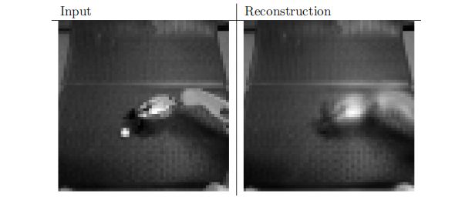
15.3 Semi-Supervised Disentangling of Causal Factors
Figure 15.5: An autoencoder trained with mean squared error for a robotics task has failed to reconstruct a ping pong ball. The existence of the ping pong ball and all of its spatial coordinates are important underlying causal factors that generate the image and are relevant to the robotics task. Unfortunately, the autoencoder has limited capacity, and the training with mean squared error did not identify the ping pong ball as being salient enough to encode. Images graciously provided by Chelsea Finn.

Slide 72
15.3 Semi-Supervised Disentangling of Causal Factors
Other definitions of salience are possible. For example, if a group of pixels follow a highly recognizable pattern, even if that pattern does not involve extreme brightness or darkness, then that pattern could be considered extremely salient. One way to implement such a definition of salience is to use a recently developed approach called generative adversarial networks (Goodfellow et al., 2014c). In this approach, a generative model is trained to fool a feedforward classifier. The feedforward classifier attempts to recognize all samples from the generative model as being fake, and all samples from the training set as being real. In this framework, any structured pattern that the feedforward network can recognize is highly salient.

Slide 73
15.3 Semi-Supervised Disentangling of Causal Factors
The generative adversarial network will be described in more detail in Sec. 20.10.4. For the purposes of the present discussion, it is sufficient to understand that they learn how to determine what is salient. Lotter et al. (2015) showed that models trained to generate images of human heads will often neglect to generate the ears when trained with mean squared error, but will successfully generate the ears when trained with the adversarial framework. Because the ears are not extremely bright or dark compared to the surrounding skin, they are not especially salient according to mean squared error loss, but their highly recognizable shape and consistent position means that a feedforward network can easily learn to detect them, making them highly salient under the generative adversarial framework.

Slide 74
15.3 Semi-Supervised Disentangling of Causal Factors
See Fig. 15.6 for example images. Generative adversarial networks are only one step toward determining which factors should be represented. We expect that future research will discover better ways of determining which factors to represent, and develop mechanisms for representing different factors depending on the task.

Slide 75
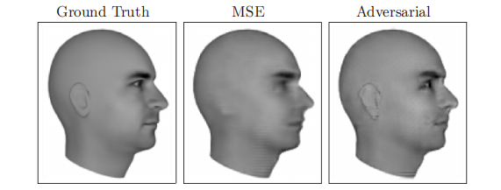
15.3 Semi-Supervised Disentangling of Causal Factors
Figure 15.6: Predictive generative networks provide an example of the importance of learning which features are salient. In this example, the predictive generative network has been trained to predict the appearance of a 3-D model of a human head at a specific viewing angle. (Left) Ground truth. This is the correct image, that the network should emit. (Center) Image produced by a predictive generative network trained with mean squared error alone. Because the ears do not cause an extreme difference in brightness compared to the neighboring skin, they were not sufficiently salient for the model to learn to represent them. (Right) Image produced by a model trained with a combination of mean squared error and adversarial loss. Using this learned cost function, the ears are salient because they follow a predictable pattern. Learning which underlying causes are important and relevant enough to model is an important active area of research. Figures graciously provided by Lotter et al. (2015).

Slide 76
15.3 Semi-Supervised Disentangling of Causal Factors
A benefit of learning the underlying causal factors, as pointed out by Schölkopf et al. (2012), is that if the true generative process has x as an effect and y as a cause, then modeling p(x | y) is robust to changes in p(y). If the cause-effect relationship was reversed, this would not be true, since by Bayes rule, p(x | y) would be sensitive to changes in p( y). Very often, when we consider changes in distribution due to different domains, temporal non-stationarity, or changes in the nature of the task, the causal mechanisms remain invariant (“the laws of the universe are constant”) while the marginal distribution over the underlying causes can change. Hence, better generalization and robustness to all kinds of changes can be expected via learning a generative model that attempts to recoverthe causal factors h and p(x | h).

Slide 77
Chapter 15 Representation Learning
15.4 Distributed Representation
Acknowledge to: Wei Wan
Organizers: Guoqiang Zhong, Zhaoyang Niu
Machine Learning Research Group
Ocean University of China
Qingdao, China
https://github.com/AdolfKing/DeepLearningSlides

Slide 78
15.4 Distributed Representation
Distributed representations of concepts—representations composed of many ele- ments that can be set separately from each other—are one of the most important tools for representation learning. Distributed representations are powerful because they can use n features with k values to describe different concepts. As we have seen throughout this book, both neural networks with multiple hidden units and probabilistic models with multiple latent variables make use of the strategy of distributed representation. We now introduce an additional observation. Many deep learning algorithms are motivated by the assumption that the hidden units can learn to represent the underlying causal factors that explain the data, as discussed in Sec. 15.3. Distributed representations are natural for this approach, because each direction in representation space can correspond to the value of a different underlying configuration variable.

Slide 79
15.4 Distributed Representation
An example of a distributed representation is a vector of n binary features, which can take configurations , each potentially corresponding to a different region in input space, as illustrated in Fig. 15.7. This can be compared with a symbolic representation, where the input is associated with a single symbol or category. If there are n symbols in the dictionary, one can imagine n feature detectors, each corresponding to the detection of the presence of the associated category. In that case only n different configurations of the representation space are possible, carving n different regions in input space, as illustrated in Fig. 15.8. Such a symbolic representation is also called a one-hot representation, since it can be captured by a binary vector with n bits that are mutually exclusive e (only one of them can be active).

Slide 80
15.4 Distributed Representation
A symbolic representation is a specific example of the broader class of non-distributed representations, which are representations that may contain many entries but without significant meaningful separate control over each entry.
Examples of learning algorithms based on non-distributed representations include:
• Clustering methods, including the k-means algorithm: each input point is assigned to exactly one cluster.
• k-nearest neighbors algorithms: one or a few templates or prototype examples are associated with a given input. In the case of k > 1, there are multiple values describing each input, but they can not be controlled separately from each other, so this does not qualify as a true distributed representation.

Slide 81
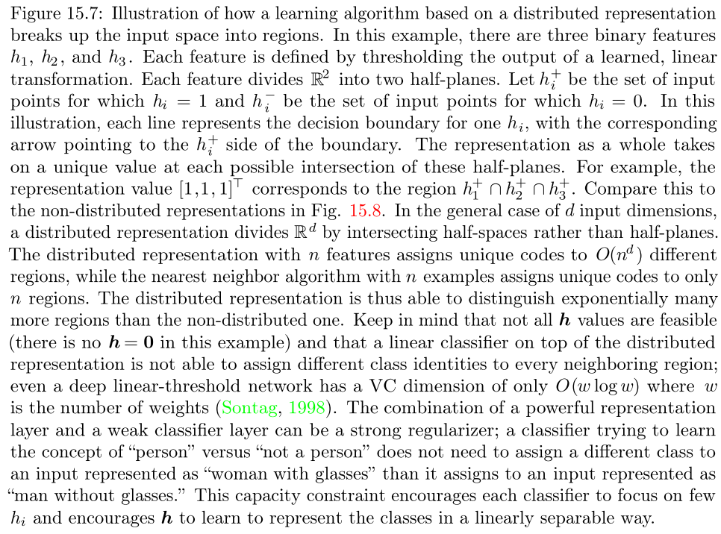
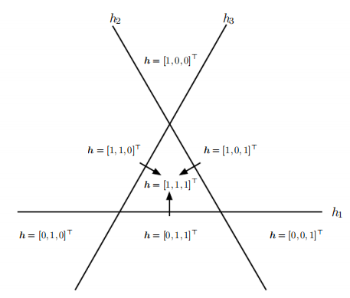
15.4 Distributed Representation

Slide 82
15.4 Distributed Representation
• Decision trees: only one leaf (and the nodes on the path from root to leaf) is activated when an input is given.
• Gaussian mixtures and mixtures of experts: the templates (cluster centers) or experts are now associated with a degree of activation. As with the k-nearest neighbors algorithm, each input is represented with multiple values, but those values cannot readily be controlled separately from each other.
• Kernel machines with a Gaussian kernel (or other similarly local kernel): although the degree of activation of each “support vector” or template example is now continuous-valued, the same issue arises as with Gaussian mixtures.

Slide 83
15.4 Distributed Representation
• Language or translation models based on n-grams. The set of contexts (sequences of symbols) is partitioned according to a tree structure of suffixes. A leaf may correspond to the last two words being and , for example. Separate parameters are estimated for each leaf of the tree (with some sharing being possible).
For some of these non-distributed algorithms, the output is not constant by parts but instead interpolates between neighboring regions. The relationship between the number of parameters (or examples) and the number of regions they can define remains linear.

Slide 84
15.4 Distributed Representation
An important related concept that distinguishes a distributed representation from a symbolic one is that generalization arises due to shared attributes between different concepts. As pure symbols, “cat” and “ dog” are as far from each other as any other two symbols. However, if one associates them with a meaningful distributed representation, then many of the things that can be said about cats can generalize to dogs and vice-versa. For example, our distributed representation may contain entries such as “has_fur” or “number_of_legs” that have the same value for the embedding of both “cat” and “dog.”Neural language models that operate on distributed representations of words generalize much better than other models that operate directly on one-hot representations of words, as discussed in Sec. 12.4. Distributed representations induce a rich similarity space, in which semantically close concepts (or inputs) are close in distance, a property that is absent from purely symbolic representations.

Slide 85
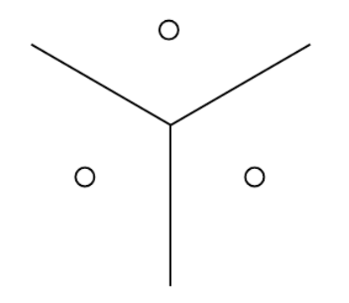
15.4 Distributed Representation
Figure 15.8: Illustration of how the nearest neighbor algorithm breaks up the input space into different regions. The nearest neighbor algorithm provides an example of a learning algorithm based on a non-distributed representation. Different non-distributed algorithms may have different geometry, but they typically break the input space into regions, with a separate set of parameters for each region. The advantage of a non-distributed approach is that, given enough parameters, it can fit the training set without solving a difficult optimization algorithm, because it is straightforward to choose a different output independently for each region. The disadvantage is that such non-distributed models generalize only locally via the smoothness prior, making it difficult to learn a complicated function with more peaks and troughs than the available number of examples. Contrast this with a distributed representation, Fig. 15.7.

Slide 86
15.4 Distributed Representation
When and why can there be a statistical advantage from using a distributed representation as part of a learning algorithm? Distributed representations can have a statistical advantage when an apparently complicated structure can be compactly represented using a small number of parameters. Some traditional non- distributed learning algorithms generalize only due to the smoothness assumption, which states that if u ≈ v, then the target function f to be learned has the property that f(u) ≈ f(v), in general. There are many ways of formalizing such an assumption, but the end result is that if we have an example (x, y ) for which we know that f (x) ≈ y, then we choose an estimator that approximately satisfies these constraints while changing as little as possible when we move to a nearby input x + ϵ .

Slide 87
15.4 Distributed Representation
This assumption is clearly very useful, but it suffers from the curse of dimensionality: in order to learn a target function that increases and decreases many times in many different regions,1 we may need a number of examples that is at least as large as the number of distinguishable regions. One can think of each of these regions as a category or symbol: by having a separate degree of freedom for each symbol (or region), we can learn an arbitrary decoder mapping from symbol to value. However, this does not allow us to generalize to new symbols for new regions.

Slide 88
15.4 Distributed Representation
If we are lucky, there may be some regularity in the target function, besides being smooth. For example, a convolutional network with max-pooling can recognize an object regardless of its location in the image, even though spatial translation of the object may not correspond to smooth transformations in the input space.

Slide 89
15.4 Distributed Representation
Let us examine a special case of a distributed representation learning algorithm, that extracts binary features by thresholding linear functions of the input. Each binary feature in this representation divides into a pair of half-spaces, as illustrated in Fig. 15.7. The exponentially large number of intersections of n of the corresponding half-spaces determines how many regions this distributed representation learner can distinguish. How many regions are generated by an arrangement of n hyperplanes in ? By applying a general result concerning the intersection of hyperplanes (Zaslavsky, 1975), one can show (Pascanu et al., 2014b) that the number of regions this binary feature representation can distinguish is

Slide 90
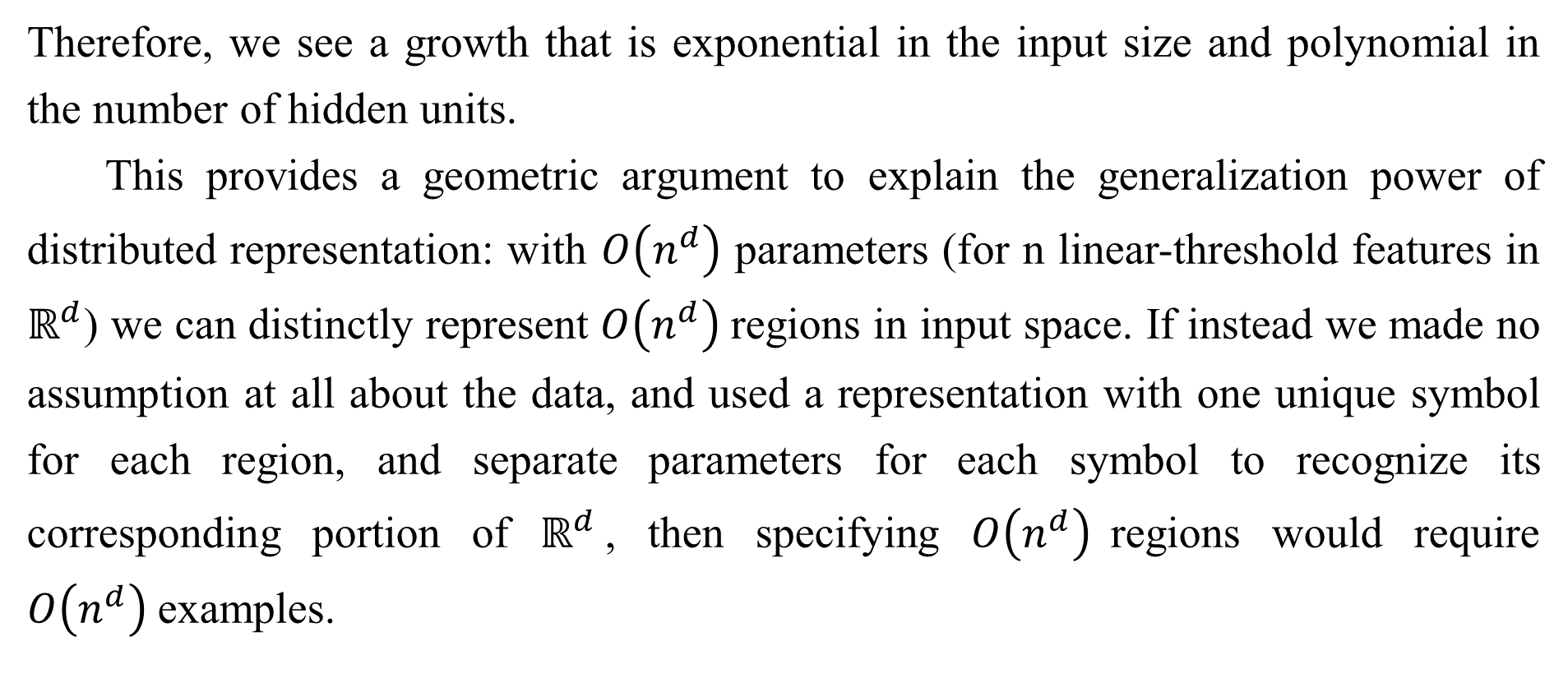
15.4 Distributed Representation
Therefore, we see a growth that is exponential in the input size and polynomial in the number of hidden units.
This provides a geometric argument to explain the generalization power of distributed representation: with $O\left(n^{d}\right)$ parameters (for n linear-threshold features in $ℝ^{d}$) we can distinctly represent $O\left(n^{d}\right)$regions in input space. If instead we made no assumption at all about the data, and used a representation with one unique symbol for each region, and separate parameters for each symbol to recognize its corresponding portion of $ℝ^{d}$, then specifying $O\left(n^{d}\right)$regions would require $O\left(n^{d}\right)$examples.

Slide 91
15.4 Distributed Representation
More generally, the argument in favor of the distributed representation could be extended to the case where instead of using linear threshold units we use nonlinear, possibly continuous, feature extractors for each of the attributes in the distributed representation. The argument in this case is that if a parametric transformation with k parameters can learn about r regions in input space, with k << r, and if obtaining such a representation was useful to the task of interest, then we could potentially generalize much better in this way than in a non-distributed setting where we would need O(r) examples to obtain the same features and associated partitioning of the input space into r regions.

Slide 92
15.4 Distributed Representation
Using fewer parameters to represent the model means that we have fewer parameters to fit, and thus require far fewer training examples to generalize well. A further part of the argument for why models based on distributed represen- tations generalize well.
A further part of the argument for why models based on distributed represen- tations generalize well is that their capacity remains limited despite being able to distinctly encode so many different regions. For example, the VC dimension of a neural network of linear threshold units is only O(w log w), where w is the number of weights (Sontag, 1998).

Slide 93
15.4 Distributed Representation
This limitation arises because, while we can assign very many unique codes to representation space, we cannot use absolutely all of the code space, nor can we learn arbitrary functions mapping from the representation space h to the output y using a linear classifier. The use of a distributed representation combined with a linear classifier thus expresses a prior belief that the classes to be recognized are linearly separable as a function of the underlying causal factors captured by h. We will typically want to learn categories such as the set of all images of all green objects or the set of all images of cars, but not categories that require nonlinear, XOR logic.

Slide 94
15.4 Distributed Representation
For example, we typically do not want to partition the data into the set of all red cars and green trucks as one class and the set of all green cars and red trucks as another class.
The ideas discussed so far have been abstract, but they may be experimentally validated. Zhou et al. (2015) find that hidden units in a deep convolutional network trained on the ImageNet and Places benchmark datasets learn features that are very often interpretable, corresponding to a label that humans would naturally assign. In practice it is certainly not always the case that hidden units learn something has a simple linguistic name, but it is interesting to see this emerge near the top levels of the best computer vision deep networks.

Slide 95
15.4 Distributed Representation
What such features have in common is that one could imagine learning about each of them without having to see all the configurations of all the others. Radford et al. (2015) demonstrated that a generative model can learn a representation of images of faces, with separate directions in representation space capturing different underlying factors of variation. Fig. 15.9 demonstrates that one direction in representation space corresponds to whether the person is male or female, while another corresponds to whether the person is wearing glasses. These features were discovered automatically, not fixed a priori. There is no need to have labels for the hidden unit classifiers: gradient descent on an objective function of interest naturally learns semantically interesting features, so long as the task requires such features.

Slide 96
15.4 Distributed Representation
We can learn about the distinction between male and female, or about the presence or absence of glasses, without having to characterize all of the configurations of the n − 1 other features by examples covering all of these combinations of values. This form of statistical separability is what allows one to generalize to new configurations of a person’s features that have never been seen during training.

Slide 97
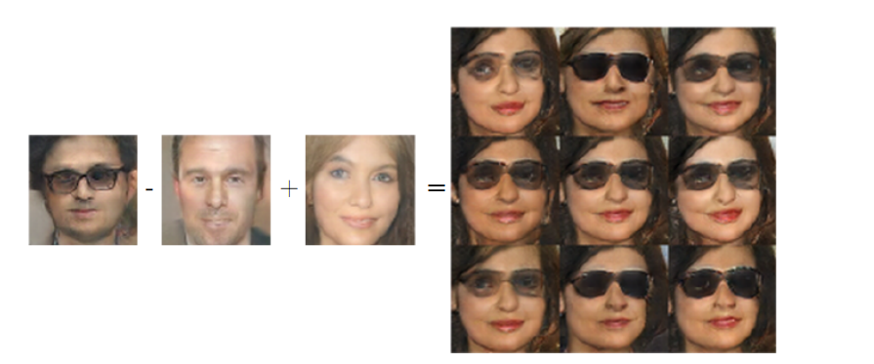
15.4 Distributed Representation
Figure 15.9: A generative model has learned a distributed representation that disentangles the concept of gender from the concept of wearing glasses. If we begin with the repre- sentation of the concept of a man with glasses, then subtract the vector representing the concept of a man without glasses, and finally add the vector representing the concept of a woman without glasses, we obtain the vector representing the concept of a woman with glasses. The generative model correctly decodes all of these representation vectors to images that may be recognized as belonging to the correct class. Images reproduced with permission from Radford et al. (2015).

Slide 98
Chapter 15 Representation Learning
15.5 Exponential Gains from Depth
Acknowledge to: Wei Wan
Organizers: Guoqiang Zhong, Zhaoyang Niu
Machine Learning Research Group
Ocean University of China
Qingdao, China
https://github.com/AdolfKing/DeepLearningSlides

Slide 99
15.5 Exponential Gains from Depth
We have seen in Sec. 6.4.1 that multilayer perceptrons are universal approximators, and that some functions can be represented by exponentially smaller deep networks compared to shallow networks. This decrease in model size leads to improved statistical efficiency. In this section, we describe how similar results apply more generally to other kinds of models with distributed hidden representations.
In Sec. 15.4, we saw an example of a generative model that learned about the explanatory factors underlying images of faces, including the person’s gender and whether they are wearing glasses. The generative model that accomplished this task was based on a deep neural network. It would not be reasonable to expect a shallow network, such as a linear network, to learn the complicated relationship between these abstract explanatory factors and the pixels in the image.

Slide 100
15.5 Exponential Gains from Depth
In this and other AI tasks, the factors that can be chosen almost independently in order to generate data are more likely to be very high-level and related in highly nonlinear ways to the input. We argue that this demands deep distributed representations, where the higher level features (seen as functions of the input) or factors (seen as generative causes) are obtained through the composition of many nonlinearities.

Slide 101
15.5 Exponential Gains from Depth
It has been proven in many different settings that organizing computation through the composition of many nonlinearities and a hierarchy of reused features can give an exponential boost to statistical efficiency, on top of the exponential boost given by using a distributed representation. Many kinds of networks (e.g., with saturating nonlinearities, Boolean gates, sum/products, or RBF units) with a single hidden layer can be shown to be universal approximators. A model family that is a universal approximator can approximate a large class of functions (including all continuous functions) up to any non-zero tolerance level, given enough hidden units.

Slide 102
15.5 Exponential Gains from Depth
However, the required number of hidden units may be very large. Theoretical results concerning the expressive power of deep architectures state that there are families of functions that can be represented efficiently by an architecture of depth k, but would require an exponential number of hidden units (with respect to the input size) with insufficient depth (depth 2 or depth k − 1).
In Sec. 6.4.1, we saw that deterministic feedforward networks are universal approximators of functions. Many structured probabilistic models with a single hidden layer of latent variables, including restricted Boltzmann machines and deep belief networks, are universal approximators of probability distributions (Le Roux and Bengio, 2008, 2010; Montúfar and Ay, 2011; Montúfar, 2014; Krause et al., 2013).

Slide 103
15.5 Exponential Gains from Depth
In Sec. 6.4.1, we saw that a sufficiently deep feedforward network can have an exponential advantage over a network that is too shallow. Such results can also be obtained for other models such as probabilistic models. One such probabilistic model is the sum-product network or SPN (Poon and Domingos, 2011). These models use polynomial circuits to compute the probability distribution over a set of random variables. Delalleau and Bengio (2011) showed that there exist probability distributions for which a minimum depth of SPN is required to avoid needing an exponentially large model. Later, Martens and Medabalimi (2014) showed that there are significant differences between every two finite depths of SPN, and that some of the constraints used to make SPNs tractable may limit their representational power.

Slide 104
15.5 Exponential Gains from Depth
Another interesting development is a set of theoretical results for the expressive power of families of deep circuits related to convolutional nets, highlighting an exponential advantage for the deep circuit even when the shallow circuit is allowed to only approximate the function computed by the deep circuit (Cohen et al., 2015). By comparison, previous theoretical work made claims regarding only the case where the shallow circuit must exactly replicate particular functions.

Slide 105
Chapter 15 Representation Learning
15.6 Providing Clues to Discover Underlying Causes
Acknowledge to: Wei Wan
Organizers: Guoqiang Zhong, Zhaoyang Niu
Machine Learning Research Group
Ocean University of China
Qingdao, China
https://github.com/AdolfKing/DeepLearningSlides

Slide 106
15.6 Providing Clues to Discover Underlying Causes
To close this chapter, we come back to one of our original questions: what makes one representation better than another? One answer, first introduced in Sec. 15.3, is that an ideal representation is one that disentangles the underlying causal factors of variation that generated the data, especially those factors that are relevant to our applications. Most strategies for representation learning are based on introducing clues that help the learning to find these underlying factors of variations. The clues can help the learner separate these observed factors from the others.Supervised learning provides a very strong clue: a label y, presented with each x, that usually specifies the value of at least one of the factors of variation directly.

Slide 107
15.6 Providing Clues to Discover Underlying Causes
More generally, to make use of abundant unlabeled data, representation learning makes use of other, less direct, hints about the underlying factors. These hints take the form of implicit prior beliefs that we, the designers of the learning algorithm, impose in order to guide the learner. Results such as the no free lunch theorem show that regularization strategies are necessary to obtain good generalization. While it is impossible to find a universally superior regularization strategy, one goal of deep learning is to find a set of fairly generic regularization strategies that are applicable to a wide variety of AI tasks, similar to the tasks that people and animals are able to solve.

Slide 108
15.6 Providing Clues to Discover Underlying Causes
We provide here a list of these generic regularization strategies. The list isclearly not exhaustive, but gives some concrete examples of ways that learning algorithms can be encouraged to discover features that correspond to underlying factors. This list was introduced in Sec. 3.1 of Bengio et al. (2013d) and has been partially expanded here.
• Smoothness: This is the assumption that f(x + ϵd) ≈ f(x) for unit d and small ϵ. This assumption allows the learner to generalize from training examples to nearby points in input space. Many machine learning algorithms leverage this idea, but it is insufficient to overcome the curse of dimensionality.

Slide 109
15.6 Providing Clues to Discover Underlying Causes
• Linearity: Many learning algorithms assume that relationships between some variables are linear. This allows the algorithm to make predictions even very far from the observed data, but can sometimes lead to overly extreme predictions. Most simple machine learning algorithms that do not make the smoothness assumption instead make the linearity assumption. These are in fact different assumptions—linear functions with large weights applied to high-dimensional spaces may not be very smooth. See Goodfellow et al. (2014b) for a further discussion of the limitations of the linearity assumption.

Slide 110
15.6 Providing Clues to Discover Underlying Causes
• Multiple explanatory factors: Many representation learning algorithms are motivated by the assumption that the data is generated by multiple underlying explanatory factors, and that most tasks can be solved easily given the state of each of these factors. Sec. 15.3 describes how this view motivates semi-supervised learning via representation learning. Learning the structure of p(x) requires learning some of the same features that are useful for modeling p(y | x) because both refer to the same underlying explanatory factors. Sec. 15.4 describes how this view motivates the use of distributed representations, with separate directions in representation space corresponding to separate factors of variation.

Slide 111
15.6 Providing Clues to Discover Underlying Causes
• Causal factors: the model is constructed in such a way that it treats the factors of variation described by the learned representation h as the causes of the observed data x, and not vice-versa. As discussed in Sec. 15.3, this is advantageous for semi-supervised learning and makes the learned model more robust when the distribution over the underlying causes changes or when we use the model for a new task.
• Depth, or a hierarchical organization of explanatory factors: High- level, abstract concepts can be defined in terms of simple concepts, forming a hierarchy. From another point of view, the use of a deep architecture expresses our belief that the task should be accomplished via a multi-step program,with each step referring back to the output of the processing accomplished via previous steps.

Slide 112
15.6 Providing Clues to Discover Underlying Causes
• Shared factors across tasks: In the context where we have many tasks, corresponding to different variables sharing the same input x or where each task is associated with a subset or a function of a global input x, the assumption is that each is associated with a different subset from a common pool of relevant factors h. Because these subsets overlap, learning all the via a shared intermediate representation P (h | x) allows sharing of statistical strength between the tasks.
• Manifolds: Probability mass concentrates, and the regions in which it con- centrates are locally connected and occupy a tiny volume. In the continuous case, these regions can be approximated by low-dimensional manifolds with a much smaller dimensionality than the original space where the data lives. Many machine learning algorithms behave sensibly only on this manifold (Goodfellow et al., 2014b). Some machine learning algorithms, especially autoencoders, attempt to explicitly learn the structure of the manifold.

Slide 113
15.6 Providing Clues to Discover Underlying Causes
• Natural clustering: Many machine learning algorithms assume that each connected manifold in the input space may be assigned to a single class. The data may lie on many disconnected manifolds, but the class remains constant within each one of these. This assumption motivates a variety of learning algorithms, including tangent propagation, double backprop, the manifold tangent classifier and adversarial training.
• Temporal and spatial coherence: Slow feature analysis and related algorithms make the assumption that the most important explanatory factors change slowly over time, or at least that it is easier to predict the true underlying explanatory factors than to predict raw observations such as pixel values. See Sec. 13.3 for further description of this approach.

Slide 114
15.6 Providing Clues to Discover Underlying Causes
• Sparsity: Most features should presumably not be relevant to describing most inputs—there is no need to use a feature that detects elephant trunks when representing an image of a cat. It is therefore reasonable to impose a prior that any feature that can be interpreted as “present” or “absent” should be absent most of the time.
• Simplicity of Factor Dependencies: In good high-level representations, the factors are related to each other through simple dependencies. The simplest possible is marginal independence, , but lineardependencies or those captured by a shallow autoencoder are also reasonable assumptions. This can be seen in many laws of physics, and is assumed when plugging a linear predictor or a factorized prior on top of a learned representation.

Slide 115
15.6 Providing Clues to Discover Underlying Causes
The concept of representation learning ties together all of the many forms of deep learning. Feedforward and recurrent networks, autoencoders and deep probabilistic models all learn and exploit representations. Learning the best possible representation remains an exciting avenue of research.

Slide 116
References
Ian Goodfellow, Yoshua Bengio and Aaron Courville. Deep Learning, MIT Press, 2016. http://www.deeplearningbook.org.
Guoqiang Zhong, Xiao Ling, Li-Na Wang: From shallow feature learning to deep learning: Benefits from the Width and Depth of Deep Architectures. Wiley Interdiscip. Rev. Data Min. Knowl. Discov. 9(1), 2019.
Guoqiang Zhong, Li-Na Wang, Xiao Ling, Junyu Dong: An Overview on Data Representation Learning: From Traditional Feature Learning to Recent Deep Learning. The Journal of Finance and Data Science 2(4): 265-278, 2016.

Slide 117
Thank you!
The ebooks, papers and materials referred for these slides are downloaded from the Internet. If any of them infringe your rights, please let’s know via email address gqzhong@ouc.edu.cn. If it is true, we will delete the corresponding content immediately. These slides can be freely utilized for teaching and research. For commercial usage, please let’s know first via the same email as above.

